Slide 1
Contraction of Skeletal Muscle
50 % of the body is muscle (skeletal 40% and 10 % smooth and cardiac). Some of same basic principles of contraction apply to all three types of muscles.

Slide 2
Physiologic Anatomy of Skeletal Muscle:
Skeletal muscle>> fibers (10 to 80 Mm) in diameter. extends the entire length of the muscle and innervated by only one nerve ending, located near the middle of the fiber.
Sarcolemma: a true cell membrane of muscle fiber; and an outer coat made up collagen fibrils.
Sarcolemma fuses with a tendon fiber.
Each muscle fiber contains several hundred to several thousand myofibrils.
Myofibrils ; 1500 myosin (thick) filaments and 3000 actin (thin) filaments,
Ends of the actin filaments attach to Z disc. Actin filaments extend in both directions to inter-digitate with the myosin filaments.
Therefore, the entire muscle fiber has light and dark bands, striated appearance.
between two successive Z discs is called a sarcomere.
Titin molecules

Slide 3
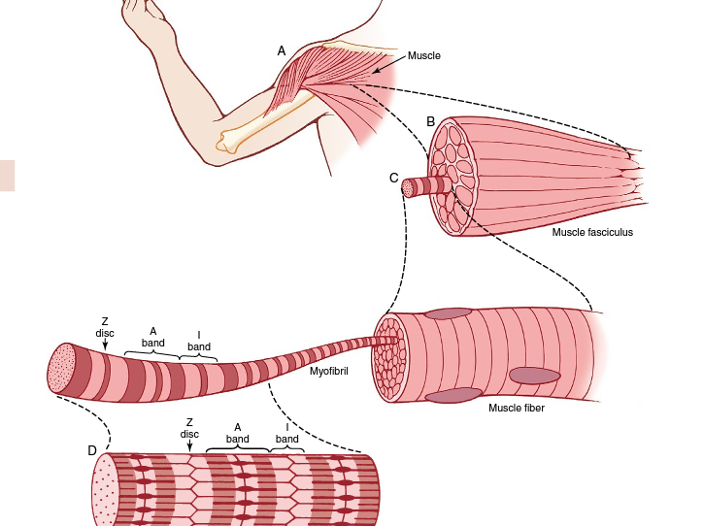

Slide 4
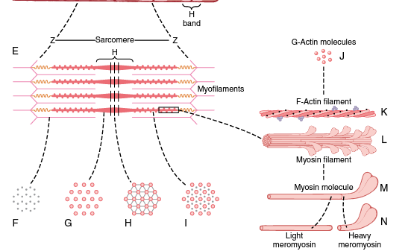

Slide 5
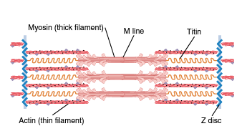

Slide 6
Sarcoplasm:
The spaces between the myofibrils ICF; containing large quantities of K⁺, Mg⁺⁺, and So₄⁻², plus multiple protein enzymes.
Also present are tremendous numbers of mitochondria.
Sarcoplasmic Reticulum:
This reticulum has a special organization that is extremely important in controlling muscle contraction.

Slide 7
Physiology of skeletal muscle contraction:
Excitation- contraction coupling; from A.P to muscle contraction:
Action potential … motor nerve to its endings on muscle fibers.
Skeletal muscle innervated by large, myelinated nerve fibers; originate from motoneurons in the anterior horns of the spinal cord.
After entering the muscle, normally branches 3-thousands.
Each nerve ending makes a junction (neuromuscular junction) at midpoint.
The A.P. initiated in the muscle fiber by the nerve signal travels in both directions toward the muscle fiber ends.
Muscle fiber membrane is called synaptic gutter, and the space between the terminal and the fiber membrane is called synaptic cleft.

Slide 8
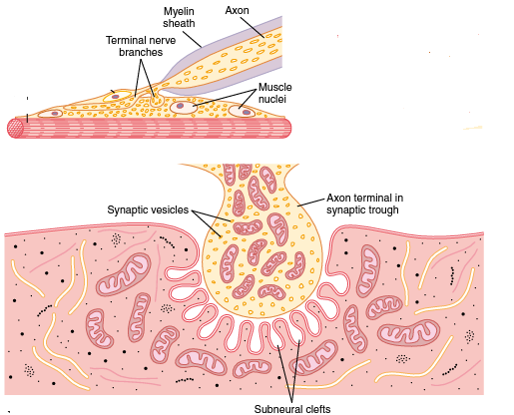

Slide 9
EXCITATION-CONTRCTION
When a nerve impulse reaches the neuromuscular junction>>>
Open voltage-gated Ca⁺⁺ channels >>>
Ca⁺⁺ diffuse to the interior of the nerve terminal>>>
Ca⁺⁺ make acetylcholine vesicles to fuse with the neural membrane >>>
release Acetylcholine (Ach) into the synaptic space >>
Ach bind with Ach receptors (Ach-gated ion channels) in the muscle fiber membrane >>
when two Ach attach to Ach receptors >> causes a conformational change that opens the channel >>>

Slide 10
EXCITATION-CONTRCTION
this channel allow the positive ions (Na ⁺ ,K ⁺ ,Ca ⁺⁺) to move easily through not -ve ions (such as Cl).
In fact, more Na+ ions flow through this channels than any other +ve ions due to Electrochemical gradient >>>
RMP of muscle fiber about −80 to −90 mV, so large numbers of Na ⁺ pass inside the fiber >>> creates a local +ve potential change inside the muscle fiber ;called end plate potential >>>

Slide 11
EXCITATION-CONTRCTION
if the amount of Na inflow inside is enough to increase local end-plate potential up to open Na-voltage gated channels (about -50 to -40mV) >>>
initiates AP (that spreads along the muscle membrane and thus causes muscle contraction.

Slide 12
EXCITATION-CONTRCTION
If A.P must not be move along fiber membrane, but must penetrate deeply into the muscle fiber to myofibrils to generate enough muscle contraction.
So, it pass through transverse tubules (T tubules) that penetrate all the way through the muscle fiber.
T tubule action potentials cause release enough Ca⁺⁺ inside the muscle fiber in the immediate vicinity of the myofibrils to make muscle contraction.

Slide 13
EXCITATION-CONTRCTION
T tubules originate from the cell membrane, they communicate with the ECF surrounding the muscle fiber and they themselves contain ECFin their lumens.
Therefore, when an AP spreads over a muscle fiber membrane, a potential change also spreads along the T tubules to the deep interior of the muscle fiber.
In addition ,Sarcoplasmic Reticulum (vesicular tubules ) inside the fiber play major role in muscle contraction; it has Ca⁺⁺ in high concentration. Sarcoplasmic reticulum release Ca++ when an A.P. occurs in the adjacent T tubules.

Slide 14
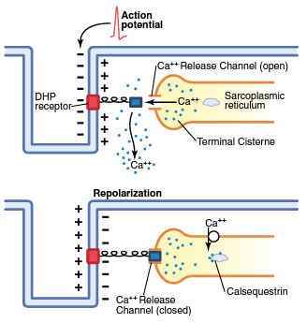

Slide 15
EXCITATION-CONTRCTION
At the end of contraction, Ca⁺⁺ pump located in the walls of the sarcoplasmic reticulum pumps Ca⁺⁺ away from the myofibrils back into the sarcoplasmic tubules

Slide 16
Destruction of the Released Ach:
Ach persists in the space for short time (a few msecs) then is removed rapidly by:
By acetylcholinesterase,
Asmall amount of Ach diffuses out of the synaptic space and is then no longer available to act on the muscle fiber membrane.

Slide 17
Mechanism of Muscle Contraction:
Releasing Ca⁺⁺ from Sarcoplasmic reticulum initiate attractive forces between the actin and myosin filaments.

Slide 18
Sliding filament mechanism;
relaxed state, the ends of the actin filaments extending from two successive Z discs.
contracted state, these actin filaments have been pulled inward among the myosin filaments, overlap one another.
Also Z discs have been pulled to each others.

Slide 19
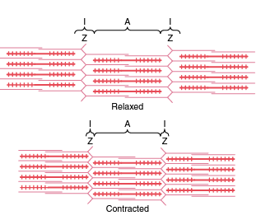

Slide 20
Causes of this sliding process:
By interaction of the cross-bridges from the myosin filaments with the actin filaments.
Under resting conditions, these forces are inactive.
But when an AP generated >> sarcoplasmic reticulum >> to release large quantities Ca ⁺⁺ >>> surround the myofibrils >>> activate the forces between the myosin and actin filaments, and contraction begins.

Slide 21
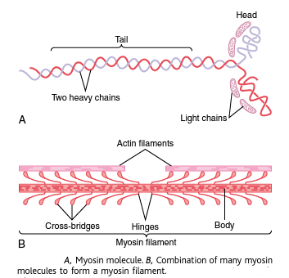
Actin and myosnin structures:

Slide 22
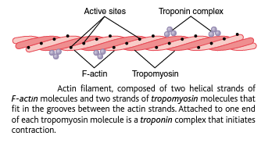

Slide 23
CONTRACTION PROCESS:
Before contraction, the heads of the cross-bridges bind with ATP.
ATPase cleaves the ATP : give ADP plus phosphate ion, bound to the head.
Conformation change of the head to be ready for binding to G- actin.
If Troponin-tropomyosin complex binds with Ca⁺⁺,
Ca ⁺⁺ combine with troponin C.
troponin complex undergoes a conformational change
Moves away from tropomyosin deeper into the groove between the two actin strands.
This “uncovers” the active sites of the actin, that make attraction with the head of the cross-bridge.

Slide 24
Pulling the head of cross-bridge toward the arm of the cross-bridge. Thus, pulling the actin filament.
ADP and phosphate ion that were previously attached to the myosin head will be released.
At the site of release of the ADP, a new molecule of ATP binds.
This binding of new ATP causes detachment of the head from the actin.
new ATP is cleaved to begin the next cycle, leading to a new power stroke.

Slide 25
Thus, the process proceeds again and again until the actin filaments pull the Z membrane up against the ends of the myosin filaments or until the load on the muscle becomes too great for further pulling to occur.

